Slide 1
Bayesian Nonparametric Model Reference Adaptive Control Using Gaussian Process Regression

Slide 2


Introduction
The Promise of Adaptive Control: “Control of complex systems with little modelling information”.
Model Reference Adaptive Control (MRAC): Good performance guarantees in presence of uncertainty.
Radial Basis Function Network (RBFN): Universal approximator adaptive model

Slide 3
Introduction
Issues: Locality near domain of RBFN centers.
Not guaranteed to capture uncertainty if away from domain
Proposal: Employ Gaussian Processes (GPs) as Bayesian nonparametric adaptive elements.
Through Gaussian Process Regression (GPR), the model uncertainty will be approximated.

Slide 4











Model Reference Adaptive Control (MRAC)
$$x_{rm}, {\dot{x}}_{rm}$$
r
$$υ_{rm}$$
$$υ$$
$$δ$$
$$x, \dot{x}$$
$$−$$
$$e$$
Reference Model
+
Inversion Model
System Dynamics
$$+$$
$${−υ}_{ad}$$
Adaptive Element
Adaptation Law
$$υ_{pd}$$
$$[K_{1}, K_{2}]$$

Slide 5
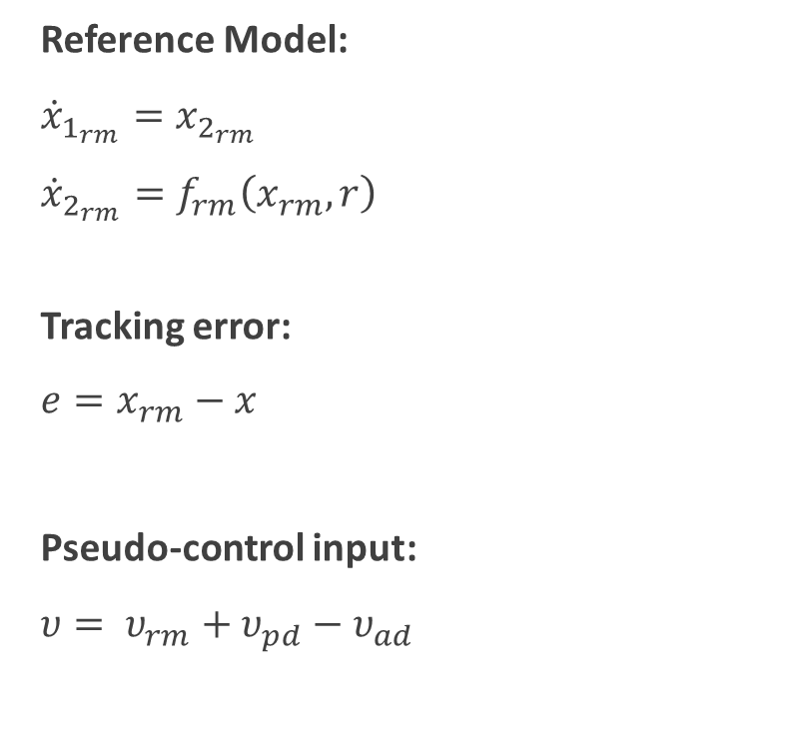
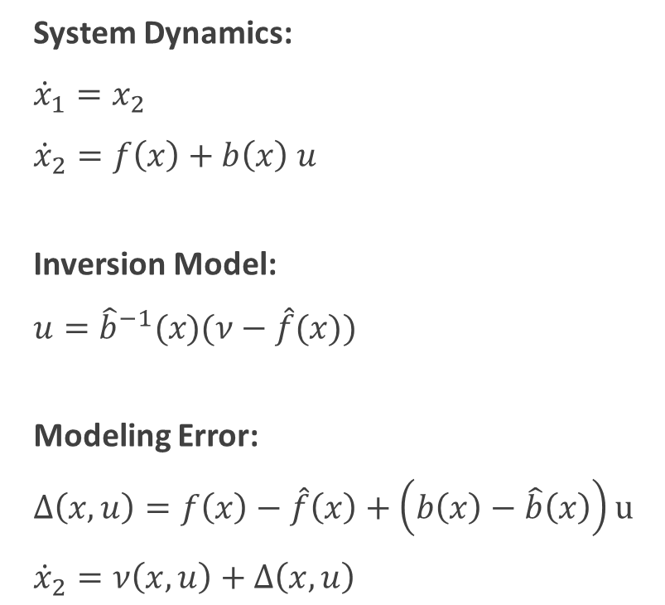
Model Reference Adaptive Control (MRAC)
System Dynamics:
${\dot{x}}_{1}=x_{2}$
${\dot{x}}_{2}=f\left(x\right)+b\left(x\right) u$
Inversion Model:
$u={\hat{b}}^{−1}(x)(ν−\hat{f}(x))$
Modeling Error:
$Δ\left(x, u\right)=f\left(x\right)−\hat{f}\left(x\right)+\left(b\left(x\right)−\hat{b}\left(x\right)\right)u$
${\dot{x}}_{2}=ν\left(x, u\right)+Δ\left(x, u\right)$
Reference Model:
${\dot{x}}_{1_{rm}}=x_{2_{rm}}$
${\dot{x}}_{2_{rm}}=f_{rm}\left(x_{rm}, r\right)$
Tracking error:
$e=x_{rm}−x$
Pseudo-control input:
$υ= υ_{rm}+υ_{pd}−υ_{ad}$

Slide 6

Model Reference Adaptive Control (MRAC)
Elements of pseudo-control input $υ:$
$υ_{rm}$: Linear feedforward term (${\dot{x}}_{2_{rm}}$)
$υ_{pd}$: Linear feedback term ($K∗e=\left[K_{1}, K_{2}\right]∗e$)
$υ_{ad}$: Adaptive term (several ways of approximating)

Slide 7
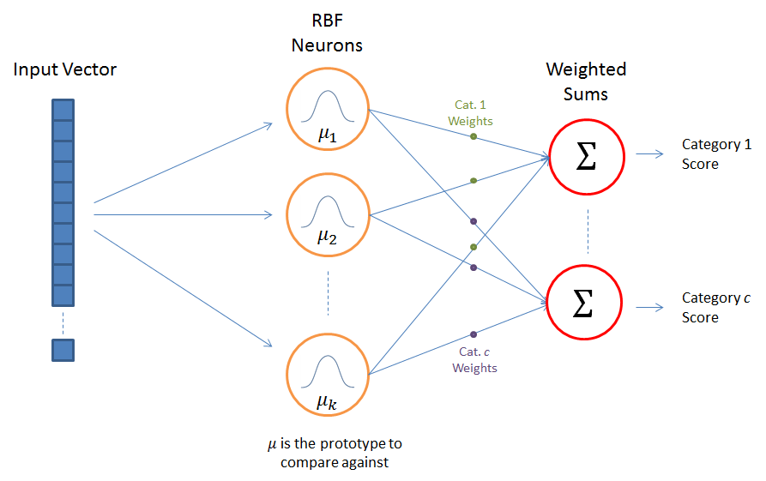
Radial Basis Function Networks (RBFNs)
Image obtained from http://mccormickml.com/2013/08/15/radial-basis-function-network-rbfn-tutorial/

Slide 8
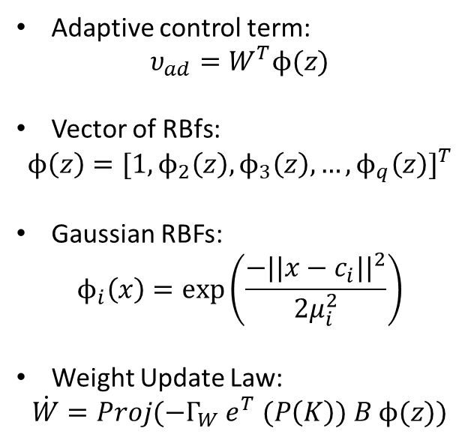

Gaussian Radial Basis Function Networks
Adaptive control term:
$$υ_{ad}=W^{T}ϕ(z)$$
Vector of RBfs:
$$ϕ\left(z\right)={[1,ϕ_{2}\left(z\right),ϕ_{3}\left(z\right), …,ϕ_{q}\left(z\right)]}^{T}$$
Gaussian RBFs:
$$ϕ_{i}\left(x\right)=exp⁡\left(\frac{−{||x−c_{i}||}^{2}}{2μ_{i}^{2}}\right)$$
Weight Update Law:
$$\dot{W}=Proj(−Γ_{W} e^{T} (P\left(K\right)) B ϕ(z))$$
Image obtained from http://mccormickml.com/2013/08/15/radial-basis-function-network-rbfn-tutorial/
$$B={[0, I]}^{T}$$

Slide 9
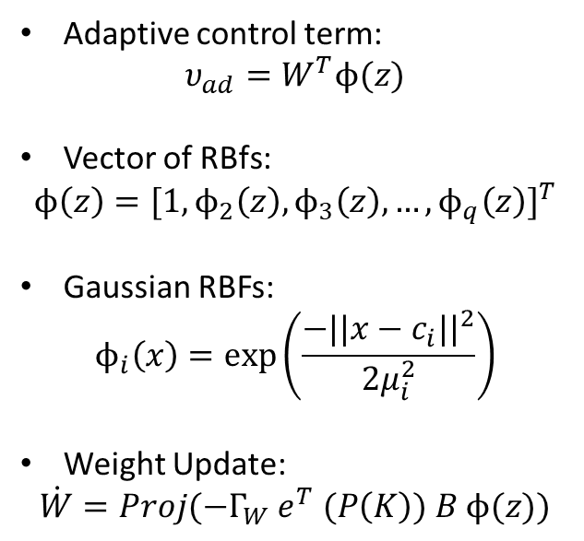
Gaussian Radial Basis Function Networks
Adaptive control term:
$$υ_{ad}=W^{T}ϕ(z)$$
Vector of RBfs:
$$ϕ\left(z\right)={[1,ϕ_{2}\left(z\right),ϕ_{3}\left(z\right), …,ϕ_{q}\left(z\right)]}^{T}$$
Gaussian RBFs:
$$ϕ_{i}\left(x\right)=exp⁡\left(\frac{−{||x−c_{i}||}^{2}}{2μ_{i}^{2}}\right)$$
Weight Update:
$$\dot{W}=Proj(−Γ_{W} e^{T} (P\left(K\right)) B ϕ(z))$$
Image obtained from http://mccormickml.com/2013/08/15/radial-basis-function-network-rbfn-tutorial/
Only locally effective. The performance of the adaptive element is bounded by its domain, determined by centers $c_{i}$.

Slide 10
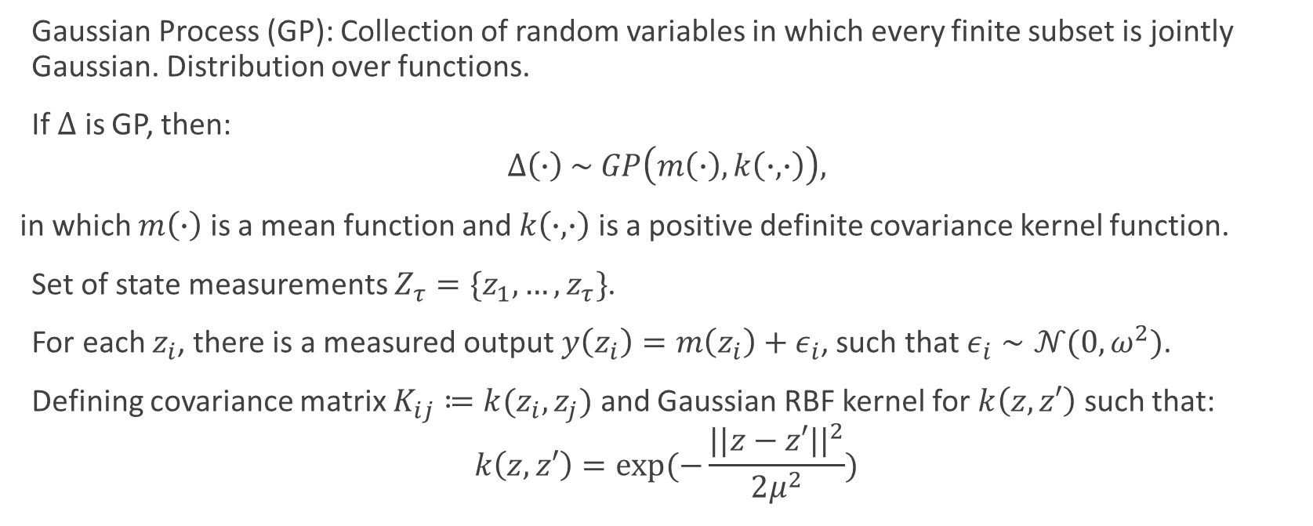
Gaussian Process Regression (GPR)
Gaussian Process (GP): Collection of random variables in which every finite subset is jointly Gaussian. Distribution over functions.
If $Δ$ is GP, then:
$$Δ\left(∙\right) \sim GP\left(m\left(∙\right), k\left(∙,∙\right)\right),$$
in which $m\left(∙\right)$ is a mean function and $k\left(∙,∙\right)$ is a positive definite covariance kernel function.
Set of state measurements $Z_{τ}=\{z_{1}, …, z_{τ}\}$.
For each $z_{i}$, there is a measured output $y\left(z_{i}\right)=m\left(z_{i}\right)+ε_{i}$, such that $ε_{i}∼𝒩(0, ω^{2})$.
Defining covariance matrix $K_{ij}≔k(z_{i},z_{j})$ and Gaussian RBF kernel for $k\left(z,z′\right)$ such that:
$$k\left(z,z′\right)=exp⁡(−\frac{{||z−z′||}^{2}}{2μ^{2}})$$

Slide 11
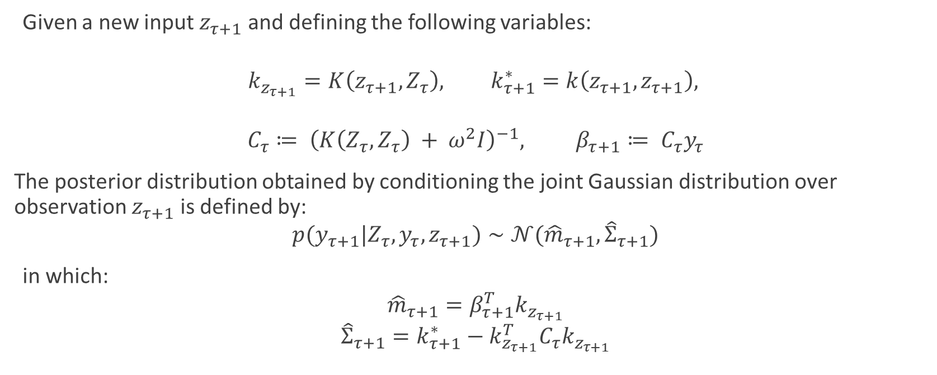
Gaussian Process Regression (GPR)
Given a new input $z_{τ+1}$ and defining the following variables:
$$k_{z_{τ+1}}=K\left(z_{τ+1}, Z_{τ}\right), k_{τ+1}^{∗}=k\left(z_{τ+1},z_{τ+1}\right),$$
$$C_{τ}≔ {\left(K\left(Z_{τ},Z_{τ}\right) + ω^{2}I\right)}^{−1}, β_{τ+1}≔ C_{τ}y_{τ}$$
The posterior distribution obtained by conditioning the joint Gaussian distribution over observation $z_{τ+1}$ is defined by:
$$p(y_{τ+1}|Z_{τ},y_{τ},z_{τ+1})∼𝒩({\hat{m}}_{τ+1}, {\hat{Σ}}_{τ+1})$$
in which:
$${\hat{m}}_{τ+1}=β_{τ+1}^{T}k_{z_{τ+1}}$$
$${\hat{Σ}}_{τ+1}=k_{τ+1}^{∗}−k_{z_{τ+1}}^{T}C_{τ}k_{z_{τ+1}}$$

Slide 12

MRAC using Gaussian Processes (GP-MRAC)
Assuming:
$$Δ\left(z\right) \sim GP(m\left(z\right), k(z,z′))$$
Proposal:
$$υ_{ad}\left(z\right) \sim GP(\hat{m}\left(z\right), k(z, z′))$$
$\hat{m}\left(z\right) i$s the estimate of $m\left(z\right)$ and will be used as $υ_{ad}$.
$\left|\left|\hat{m}\left(z\right)−m\left(z\right)\right|\right|<ε_{1}$implies $\left|\left|υ_{ad}−Δ\right|\right|<ε_{2}$.
Regular GPR not suitable to online learning processes.

Slide 13
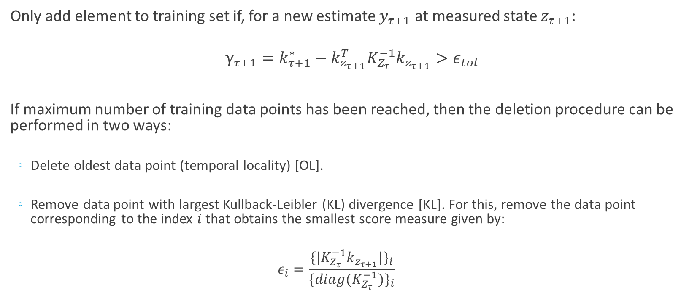
Online Gaussian Process Regression
Only add element to training set if, for a new estimate $y_{τ+1}$ at measured state $z_{τ+1}$:
$$γ_{τ+1}=k_{τ+1}^{∗}−k_{z_{τ+1}}^{T}K_{Z_{τ}}^{−1}k_{z_{τ+1}}>ε_{tol}$$
If maximum number of training data points has been reached, then the deletion procedure can be performed in two ways:
Delete oldest data point (temporal locality) [OL].
Remove data point with largest Kullback-Leibler (KL) divergence [KL]. For this, remove the data point corresponding to the index $i$ that obtains the smallest score measure given by:
$$ε_{i}=\frac{{\{|K_{Z_{τ}}^{−1}k_{z_{τ+1}}|\}}_{i}}{{\{diag(K_{Z_{τ}}^{−1})\}}_{i}}$$

Slide 14

GP-MRAC measured output
Modelling error cannot be directly measured. Therefore, the measured outputs $y$ linked to each state measurement $z$ would be approximated by using a Kalman filter to estimate ${\dot{\hat{x}}}_{2}$. Then, the measurement fed to the GPR algorithm will be:
$$y_{τ}={\dot{\hat{x}}}_{2_{τ}}−υ_{τ−1}$$

Slide 15
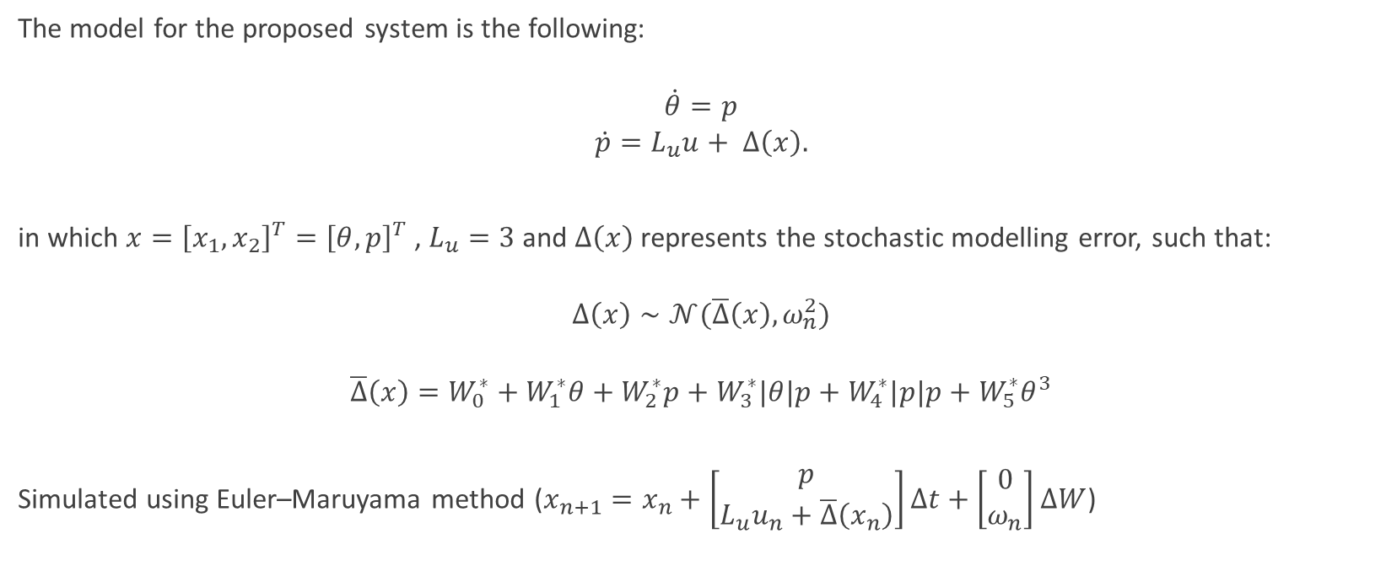
Wing-rock dynamics (stochastic differential equation)
The model for the proposed system is the following:
$$\dot{θ}=p$$
$$\dot{p}=L_{u}u+ Δ\left(x\right).$$
in which $x={\left[x_{1}, x_{2}\right]}^{T}={\left[θ, p\right]}^{T}$ , $L_{u}=3$ and $Δ\left(x\right)$ represents the stochastic modelling error, such that:
$$Δ\left(x\right)∼𝒩(\overline{Δ}\left(x\right), ω_{n}^{2})$$
$$\overline{Δ}\left(x\right)=W_{0}^{∗}+W_{1}^{∗}θ+W_{2}^{∗}p+W_{3}^{∗}|θ|p+W_{4}^{∗}|p|p+W_{5}^{∗}θ^{3}$$
Simulated using Euler–Maruyama method ($x_{n+1}=x_{n}+\left[\begin{matrix}p \\ L_{u}u_{n}+\overline{Δ}\left(x_{n}\right)\end{matrix}\right]Δt+\left[\begin{matrix}0 \\ ω_{n}\end{matrix}\right]ΔW$)

Slide 16
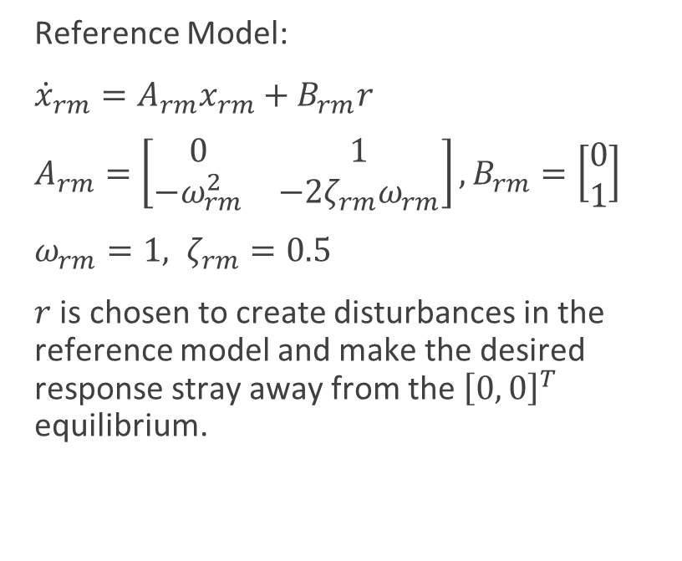
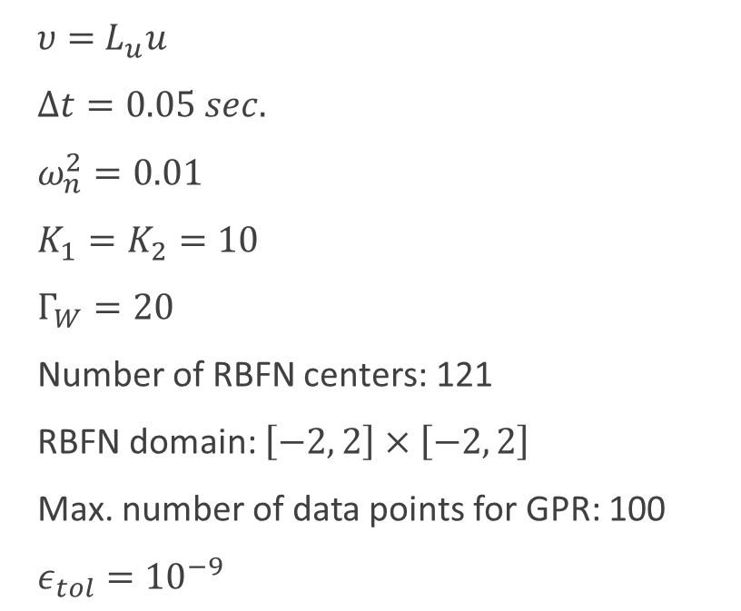
Wing-rock dynamics (simulation parameters)
Reference Model:
${\dot{x}}_{rm}=A_{rm}x_{rm}+B_{rm}r$
$A_{rm}=\left[\begin{matrix}0 & 1 \\ −ω_{rm}^{2} & −2ζ_{rm}ω_{rm}\end{matrix}\right], B_{rm}=\left[\begin{matrix}0 \\ 1\end{matrix}\right]$
$ω_{rm}=1, ζ_{rm}=0.5$
$r$ is chosen to create disturbances in the reference model and make the desired response stray away from the ${\left[0, 0\right]}^{T}$ equilibrium.
$υ=$ $L_{u}u$
$Δt=0.05 sec.$
$ω_{n}^{2}=0.01$
$K_{1}=K_{2}=10$
$Γ_{W}=20$
Number of RBFN centers: 121
RBFN domain: $\left[−2, 2\right]×\left[−2, 2\right]$
Max. number of data points for GPR: 100
$ε_{tol}={10}^{−9}$

Slide 17
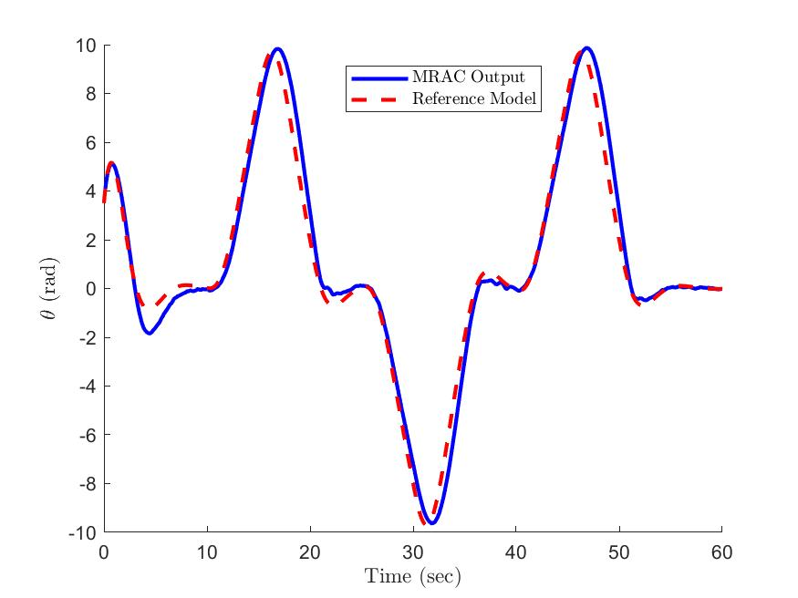
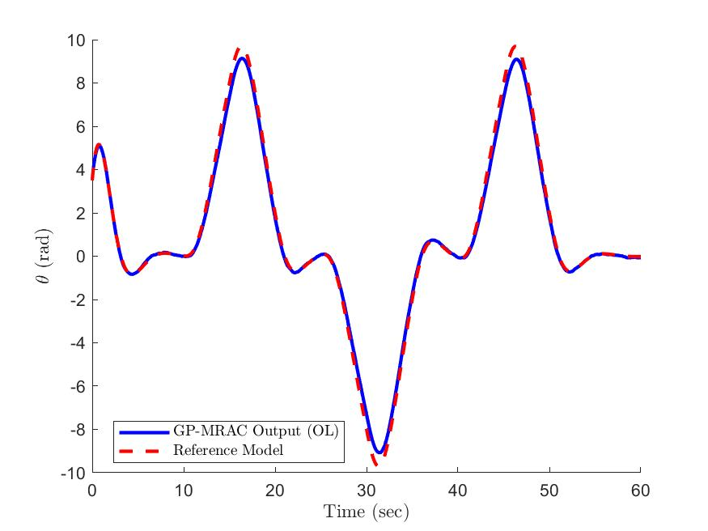
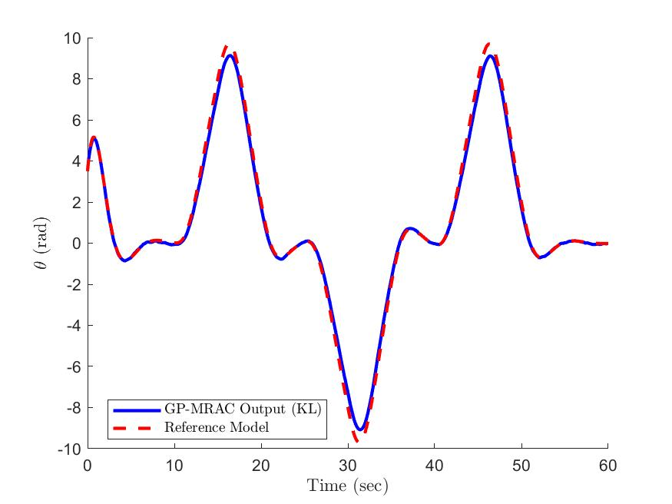
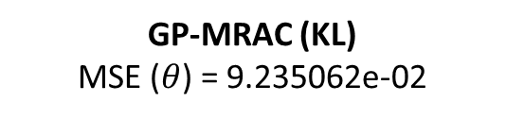
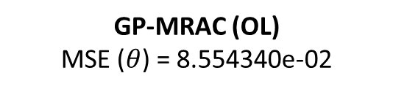

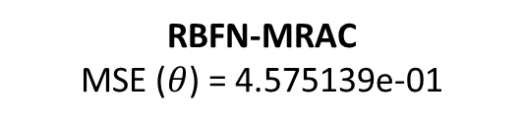
Results ($θ$)
RBFN-MRAC
MSE ($θ$) = 4.575139e-01
GP-MRAC (OL)
MSE ($θ$) = 8.554340e-02
GP-MRAC (KL)
MSE ($θ$) = 9.235062e-02

Slide 18
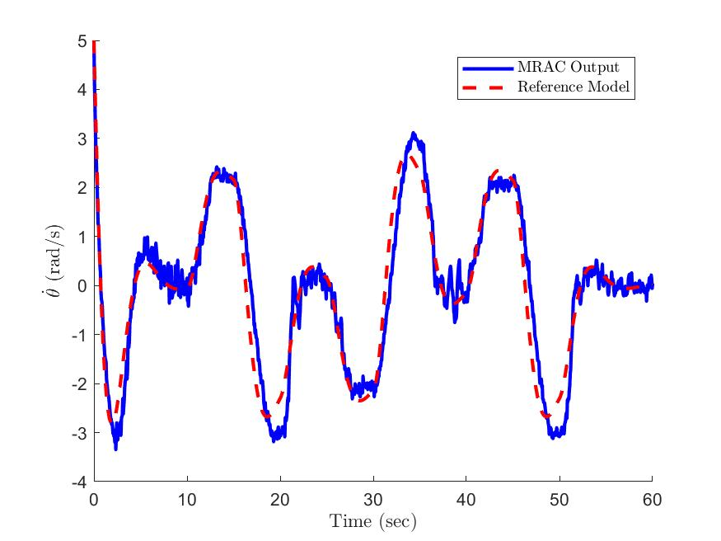
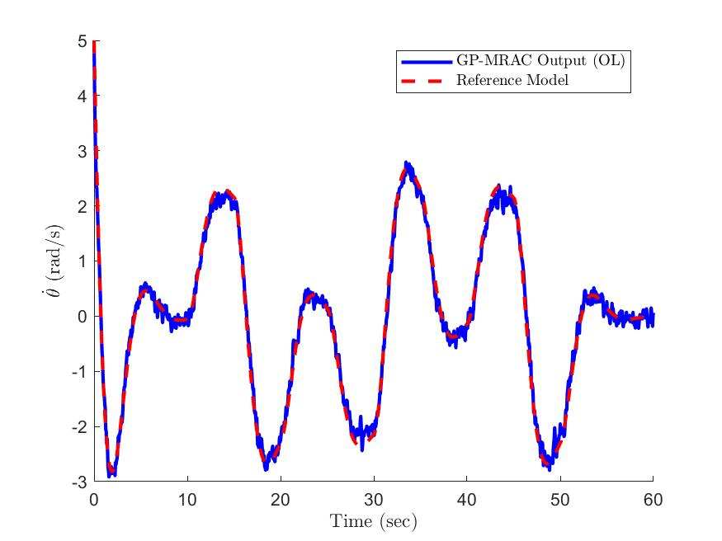
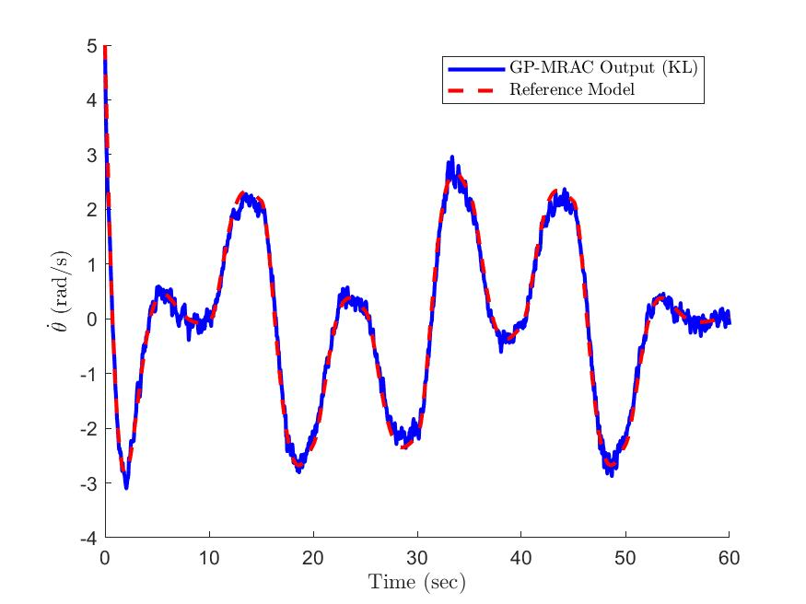
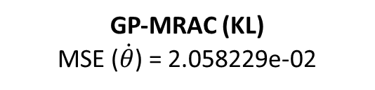
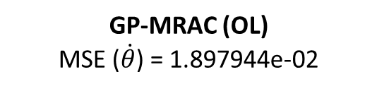

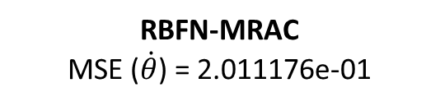
Results ($p=\dot{θ}$)
RBFN-MRAC
MSE ($\dot{θ}$) = 2.011176e-01
GP-MRAC (OL)
MSE ($\dot{θ}$) = 1.897944e-02
GP-MRAC (KL)
MSE ($\dot{θ}$) = 2.058229e-02

Slide 19
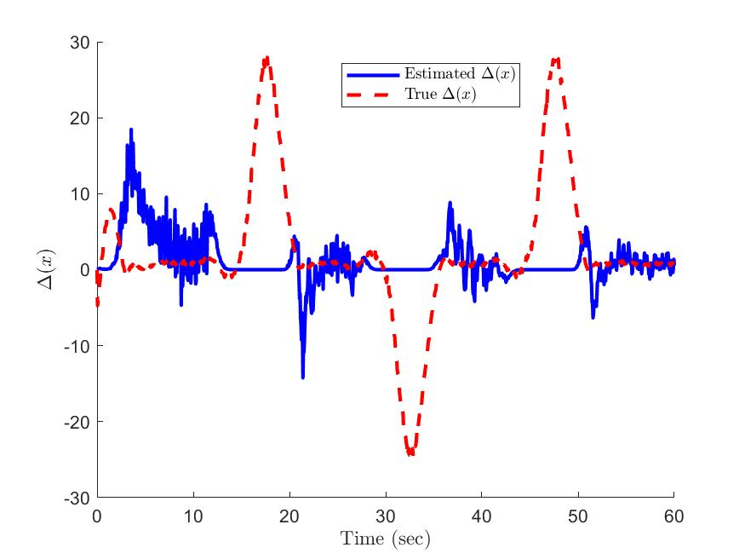
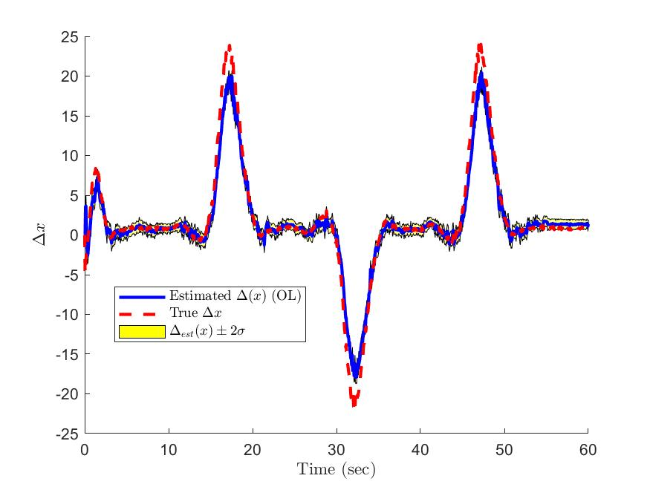
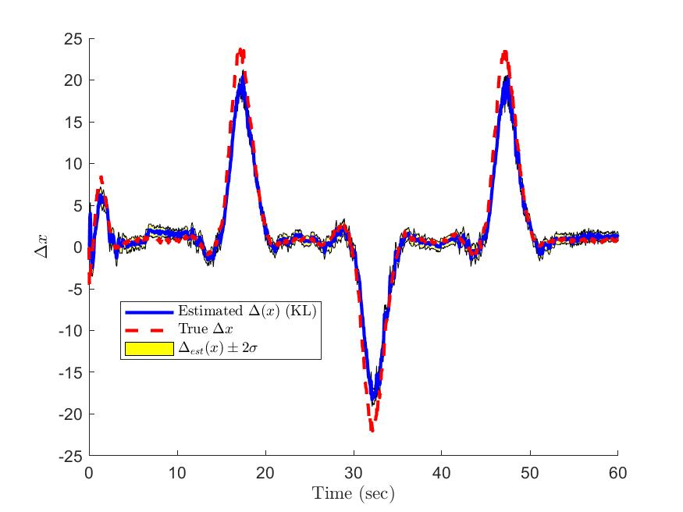
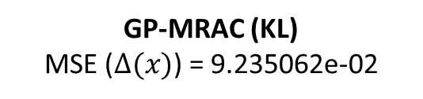
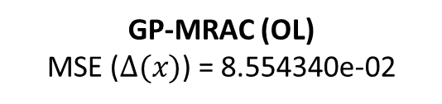

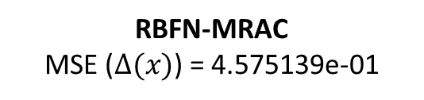
Results ($Δ$(x))
RBFN-MRAC
MSE ($Δ(x)$) = 4.575139e-01
GP-MRAC (OL)
MSE ($Δ(x)$) = 8.554340e-02
GP-MRAC (KL)
MSE ($Δ(x)$) = 9.235062e-02

Slide 20
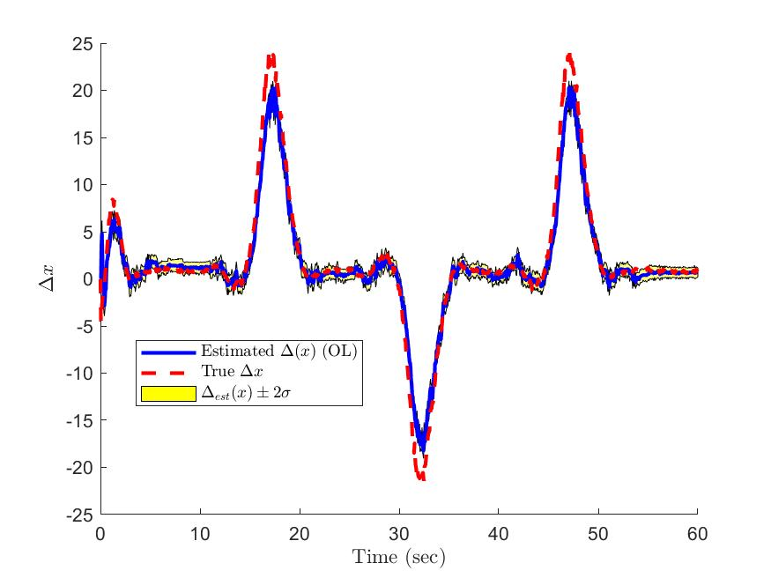
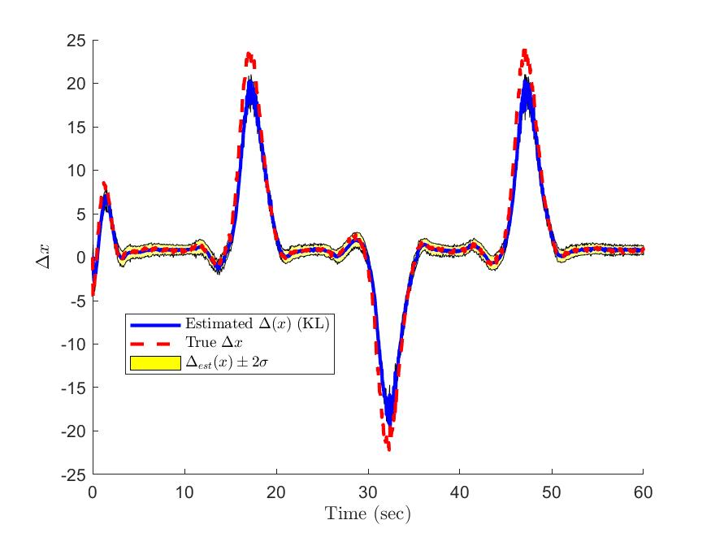
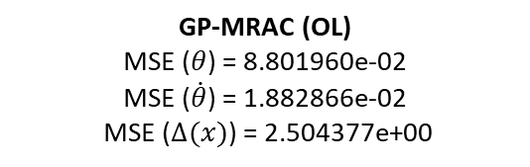

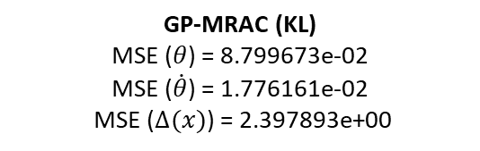
Results ($Δ$(x)) – perfect $Δ$(x) feedback
GP-MRAC (OL)
MSE ($θ$) = 8.801960e-02
MSE ($\dot{θ}$) = 1.882866e-02
MSE ($Δ(x)$) = 2.504377e+00
GP-MRAC (KL)
MSE ($θ$) = 8.799673e-02
MSE ($\dot{θ}$) = 1.776161e-02
MSE ($Δ(x)$) = 2.397893e+00

Slide 21
Conclusions
Gaussian Process Regression (GPR) is suitable for estimating model uncertainty in MRAC implementations without requiring previous knowledge of the domain of operation or the modeled uncertainty.
For online implementation, GPR requires procedures to determine when to add new data points to the training set and how to delete them when the maximum amount of data points has been reached.
Deleting the oldest data point (OL) results in a uncertainty model that has temporal locality and results in a better performance if data remains near a given set point.
Deleting data points based on KL divergence attempts to retain data with unique features in order to retain global information regarding the model.

